Slide 1
Raw sockets
Duma Amalia Diana

Slide 2

What is a raw socket?
A socket that allows for direct communication between a program and an external source without the intervention of the computer’s primary operating system.
2

Slide 3
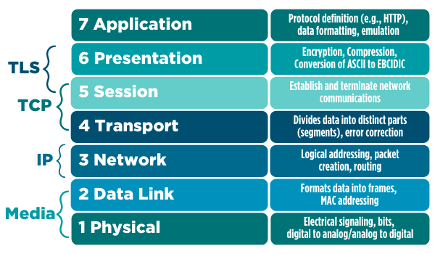
Raw sockets operate at the network OSI level, which means that transport-level headers such as TCP or UDP headers will not be automatically
decoded.

Slide 4
An important issue with security is that all packets coming in over the server’s network device can be read since network-level IP packets do not have a notion of “port”.

Slide 5
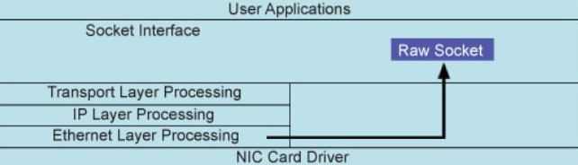
Used to receive raw packets
Packets received at the Ethernet layer will directly pass to the raw socket.
A raw socket bypasses the normal TCP/IP processing and sends the packets to the specific user application.

Slide 6
Raw sockets
A raw socket allows an application to directly access lower level protocols.
This means that a raw socket receives un-extracted packets.
No need to provide the port and IP address to a raw socket.
Other sockets
They receive data from the transport layer that contains no headers but only the payload.
This means that there is no information about the source IP address and MAC address.
Applications communicating -> they are only exchanging data.

Slide 7

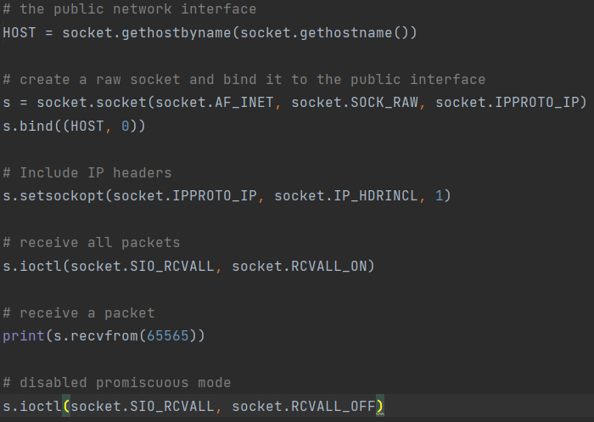
Network sniffer
We start from a simple network sniffer example.
The problem with this example is that the information we get back is not human readable so we try to parse it.

Slide 8
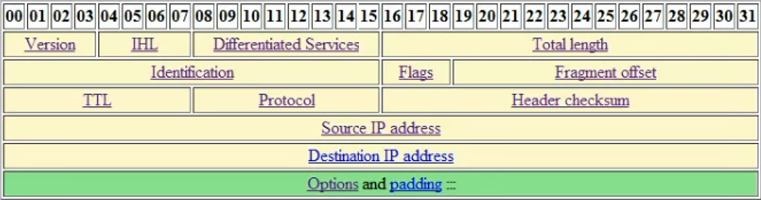
Ip header

Slide 9
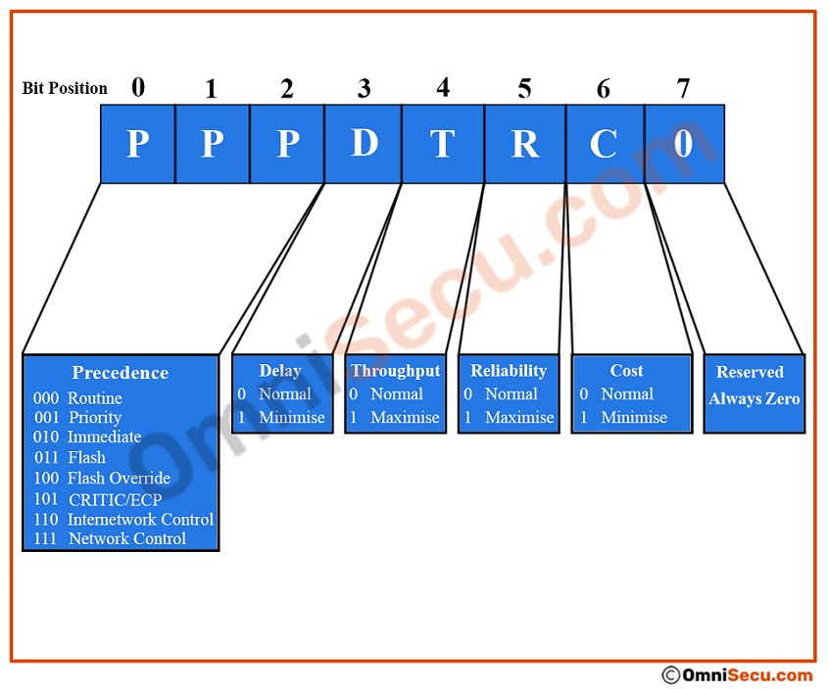
TOS

